Slide 1
Object Oriented Method && C++ Program Design
Programming
Principles and Practice Using C++
Lecture 7 – Polymorphism
Shengfa Wang

Slide 2

Polymorphism
POLY MORPHISM (TWO GREEK WORDS)
MANY FORMS
C++ polymorphism means that a call to a member function will cause a different function to be executed depending on the type of object that invokes the function.
Notes:
When we say something polymorphic in programming, what we mean is that something exhibits multiple forms or multiple behaviors.
Think of this way, if you press a computer power button right now, and your computer will turn off, and if you press it again, your computer will turn back on.
Even your computer power butter does not look like it’s changed at all. It actually has different forms and behaviors.

Slide 3
Polymorphism
Polymorphism is the phenomenon where the same message sent to two different objects produces two different set of actions. Polymorphism is broadly divided into two parts:
  Static polymorphism – exhibited by overloaded functions.
  Dynamic polymorphism – exhibited by using late binding.
Notes:
f you had code like [A=1+2;] then the compiler can make it [A=3;]
If you had code like [A=user_age+4;] then the value of A can only be calculated when user_age is known which is not known at compile-time; the program might ask the user to enter his age which can happen only at run-time.

Slide 4
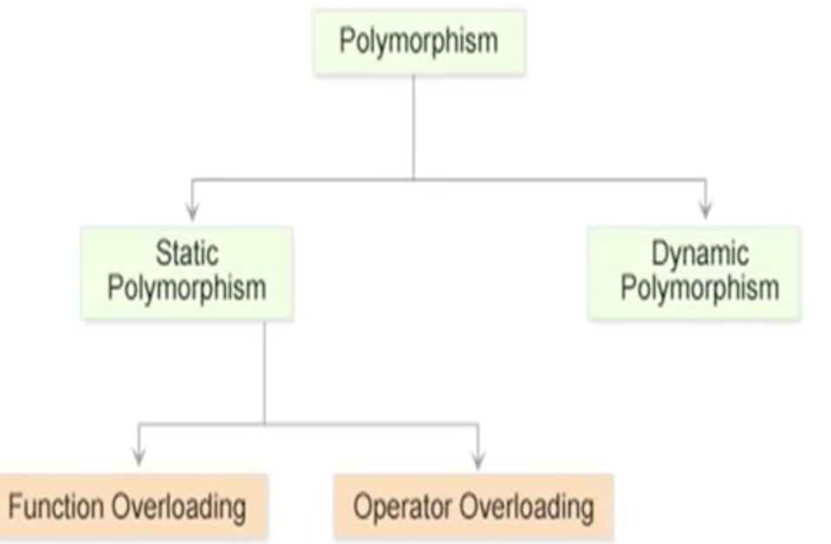
Polymorphism

Slide 5
Static Polymorphism
Static polymorphism refers to an entity existing in different physical forms simultaneously.
Static polymorphism involves binding of functions based on the number, type, and sequence of arguments.
The various types of parameters are specified in the function declaration, and therefore the function can be bound to calls at compile time.
This form of association is called early binding. The term early binding stems from the fact that when the program is executed, the calls are already bound to the appropriate functions.

Slide 6
Static Polymorphism
The resolution of a function call is based on number, type, and sequence of arguments declared for each form of the function. Consider the following function declaration:
void add(int , int);
void add(float, float);
When the add() function is invoked, the parameters passed to it will determine which version of the function will be executed. This resolution is done at compile time.

Slide 7
Dynamic Polymorphism
Dynamic polymorphism refers to an entity changing its form depending on the circumstances.
A function is said to exhibit dynamic polymorphism when it exists in more than one form, and calls to its various forms are resolved dynamically when the program is executed.
The term late binding refers to the resolution of the functions at run-time instead of compile time.
This feature increases the flexibility of the program by allowing the appropriate method to be invoked, depending on the context.

Slide 8
Early vs. Late Binding
“Early binding refers to events that occur at compile time.”
Early binding occurs when all information needed to call a function is known at compile time.
Examples :
Function calls ,overloaded function calls, and overloaded operators.

Slide 9
Early vs. Late Binding
“Late binding refers to function calls that are not resolved until run time.”
Late binding can make for somewhat slower execution times.
Example:
virtual functions
Static polymorphism is considered more efficient, and dynamic polymorphism more flexible.

Slide 10
When to use Static/ Dynamic Polymorphism
As applications are becoming larger and more complicated, the need for flexibility is increasing rapidly.
  Most users have to periodically upgrade their software, and this could become a very tedious task if static polymorphism is applied. This is because any changing requirements require a major modification in the code. In the case of dynamic binding, the function calls are resolved at run-time, thereby giving the user the flexibility to alter the call without having to modify the code.
To the programmer, efficiency and performance would probably be a primary concern, but to the user, flexibility or maintainability may be much more important. The decision is thus a trade-off between efficiency and flexibility.

Slide 11
Dynamic Binding
Dynamic binding in C++ is associated with methods invoked by pointers and references, and this is governed by the inheritance process.

Slide 12
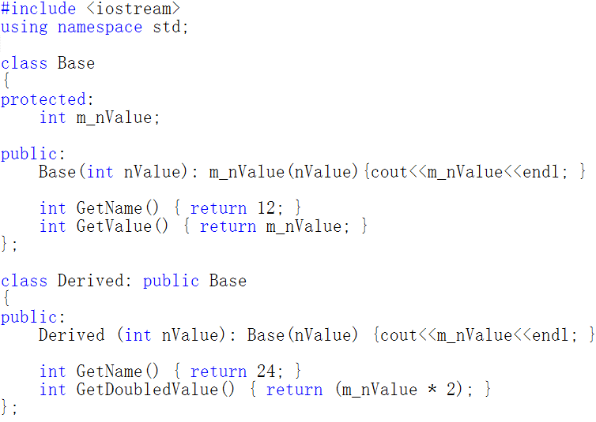

Slide 13
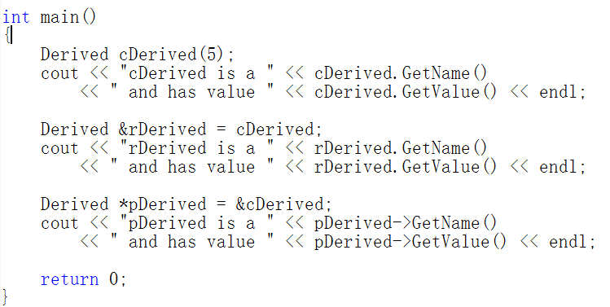
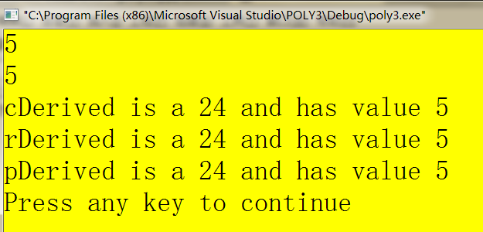

Slide 14
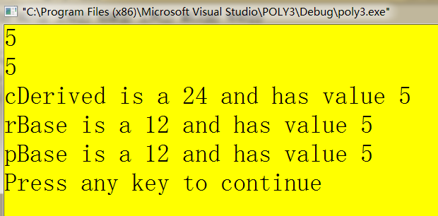
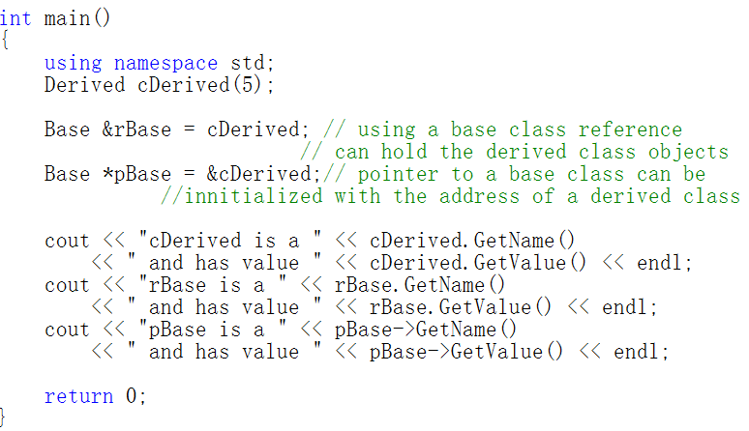
rBase. GetValueDoubled()
pBase.->GetValueDoubled()
Because rBase and pBase are a Base reference and pointer, they can only see members of Base (or any classes that Base inherited).

Slide 15
？？？ How？？？

Slide 16
Virtual functions
A virtual function is a special type of function that resolves to the most-derived version of the function with the same signature. This capability is known as polymorphism.
To make a function virtual, simply place the “virtual” keyword before the function declaration.
Note that virtual functions and virtual base classes are two entirely different concepts, even though they share the same keyword.

Slide 17
Virtual Functions
A virtual function is expected to be redefined in derived classes
Dynamic dispatch: selecting correct function at runtime
Once virtual, always virtual
class Cshape {
public:
void SetColor(int color) { m_nColor=color;}
virtual void Display( void) { cout<<"Cshape"<<endl; }
private:
int m_nColor;
};
class Crectangle: public Cshape {
public:
virtual void Display( void) { cout<<"Crectangle"<<endl; }
};
class Ctriangle: public Cshape {
virtual void Display( void) { cout<<"Ctriangle"<<endl; }
};
class Cellipse :public Cshape {
public:
virtual void Display(void) { cout<<"Cellipse"<<endl;}
};
Notes:
Once a method is declared virtual in some class C, it is virtual in every derived class of C, even if not explicitly declared as such. However, it is a good idea to declare it as virtual in the derived classes anyway for clarity.

Slide 18
Virtual Functions
void main()
{
  Cshape obShape;
  Cellipse obEllipse;
  Ctriangle obTriangle;
  Crectangle obRectangle;
  Cshape * pShape[4]= { &obShape,&obEllipse, &obTriangle,& obRectangle };
  for( int I= 0; I< 4; I++)
  pShape[I]->Display( );
}
#include<iostream>
using namespace std;
class Cshape {
public:
void SetColor(int color) { m_nColor=color;}
virtual void Display( void) { cout<<"Cshape"<<endl; }
private:
int m_nColor;
};
class Crectangle: public Cshape {
public:
virtual void Display( void) { cout<<"Crectangle"<<endl; }
};
class Ctriangle: public Cshape {
virtual void Display( void) { cout<<"Ctriangle"<<endl; }
};
class Cellipse :public Cshape {
public:
virtual void Display(void) { cout<<"Cellipse"<<endl;}
};
Cshape
Cellipse
Ctriangle
Crectangle
Remove the virtual?
Cshape
Cshape
Cshape
Cshape

Slide 19
Pure Virtual Functions
Often, a function in an interface can not be implemented
  E.g. the data needed is “hidden” in the derived class
  We must ensure that a derived class implements that function
  Make it a “pure virtual function” (=0)
This is how we define truly abstract interfaces (“pure interfaces”)
  struct Engine { // interface to electric motors
  // no data
  // (usually) no constructor
  virtual double increase(int i) =0; // must be defined in a derived class
  // …
  virtual ~Engine(); // (usually) a virtual destructor
  };
  Engine eee; // error: Collection is an abstract class

Slide 20
Pure Virtual Functions
A pure interface can then be used as a base class
  Constructors and destructors are described in detail in chapters 17-19
  Class M123 : public Engine { // engine model M123
  // representation
  public:
  M123(); // construtor: initialization, acquire resources
  double increase(int i) { /* … */ } // overrides Engine ::increase
  // …
  ~M123(); // destructor: cleanup, release resources
  };
  M123 window3_control; // OK

Slide 21
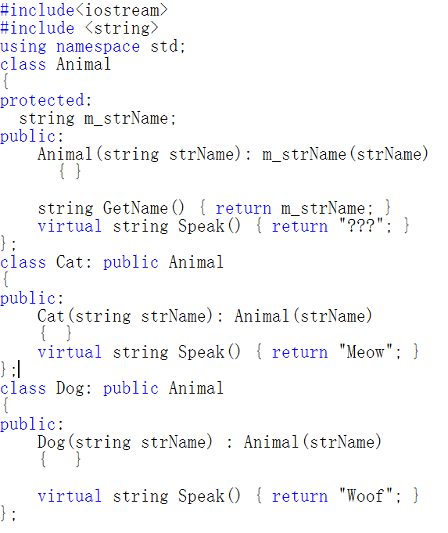
mn

Slide 22
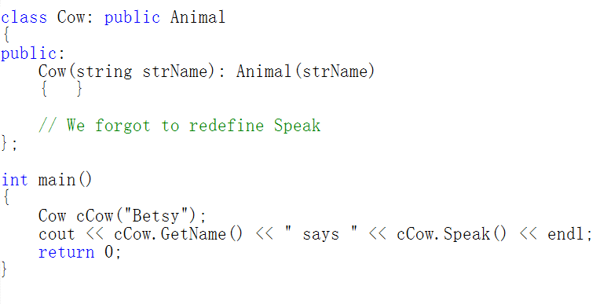
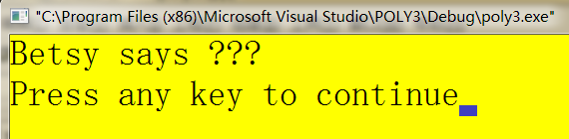

Slide 23

Pure Virtual Functions
When a virtual function is made pure, any derived class must provide its definition.
If the derived class fails to override the pure virtual function, a compile-time error will result.
NOTE:
When a virtual function is declared as pure, then all derived classes must override it.

Slide 24
Abstract Classes
“A class that contains at least one pure virtual function then it is said to be abstract class.”
No objects of an abstract class be created.
Abstract class constitutes an incomplete type that is used as a foundation for derived classes.

Slide 25
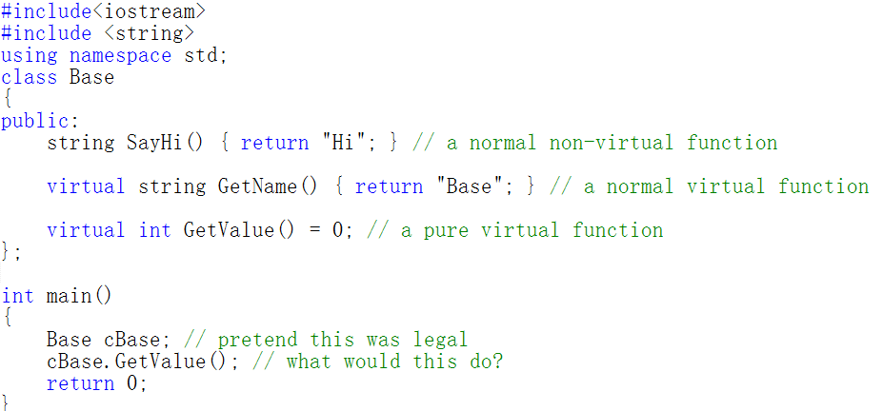
When we add a pure virtual function to our class, we are effectively saying, “it is up to the derived classes to implement this function”.

Slide 26
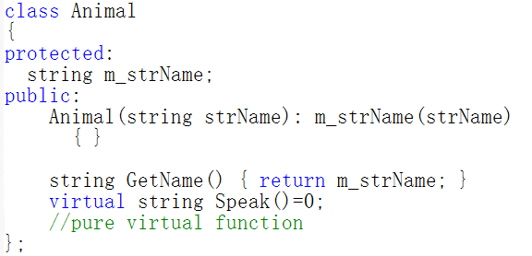
Pure virtual functions

Slide 27
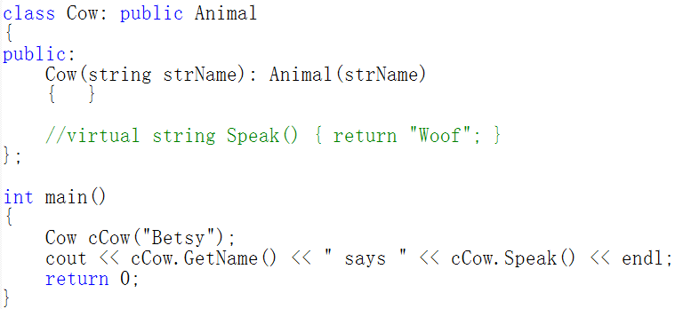
Cannot be instantiated
Any derived class that defines without definition of the virtual function for an abstract base class will be considered an abstract base class as well.

Slide 28
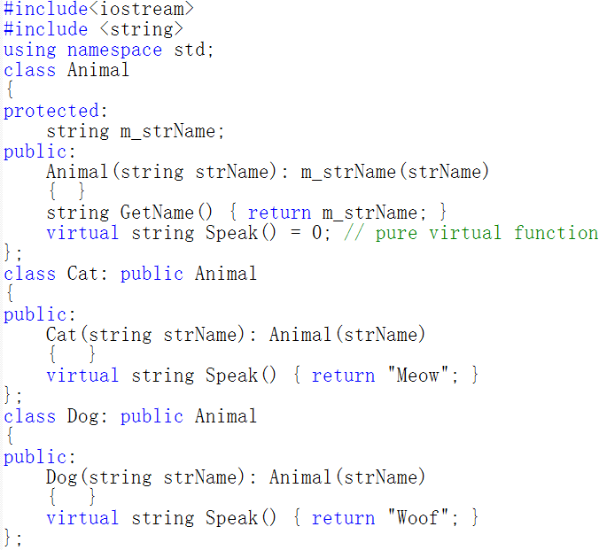

Slide 29
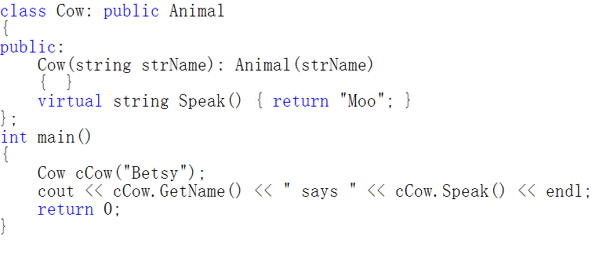
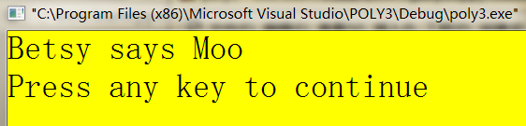

Slide 30
Using Virtual Functions
We can achieve the most powerful and flexible ways to implement the "one interface, multiple methods“.
We can create a class hierarchy that moves from general to specific (base to derived).

Slide 31
Virtual Functions
Restrictions:
All aspects of its prototype must be the same as base class virtual function.
Virtual functions are of non-static members.
Virtual functions can not be friends.
Constructor functions cannot be virtual.
But destructor functions can be virtual.
NOTE:
Function overriding is used to describe virtual function redefinition by a derived class.

Slide 32
Overriding vs Overloading
When overriding, you change the method behavior for a derived class.
Overloading simply involves having a method with the same name within the class.
Both of them belong to polymorphism!

Slide 33
More?

Slide 34
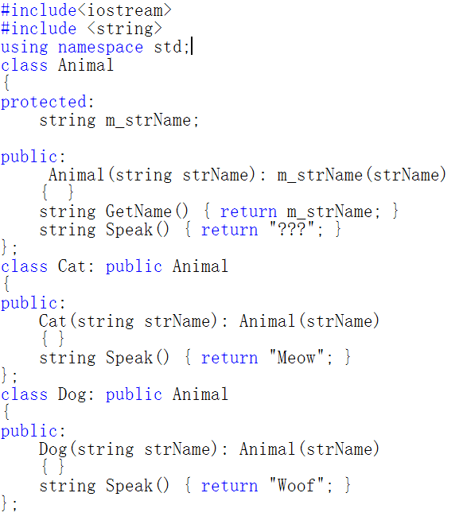

Slide 35
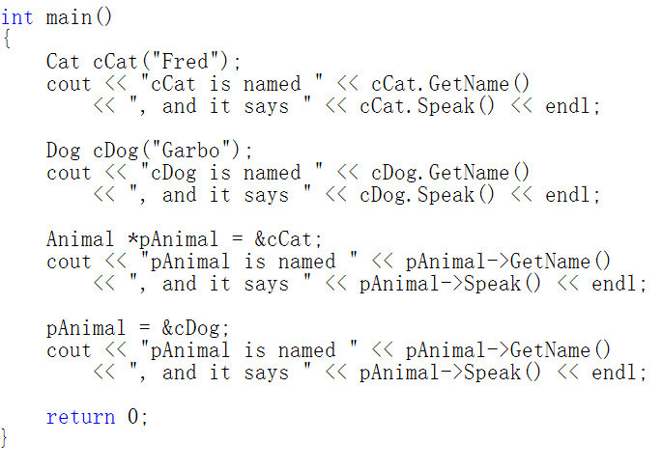

Slide 36
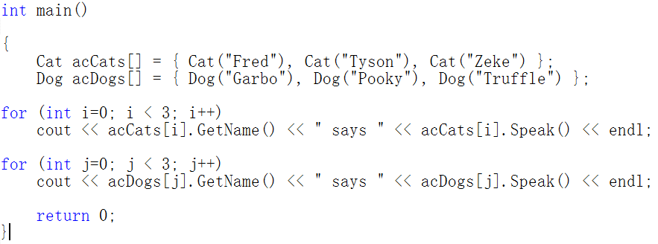
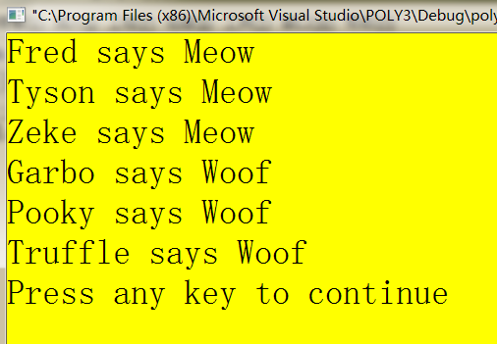

Slide 37
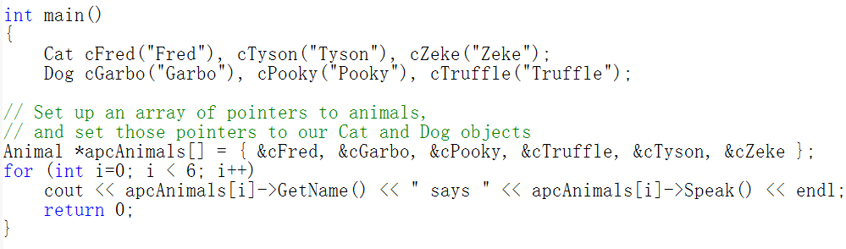
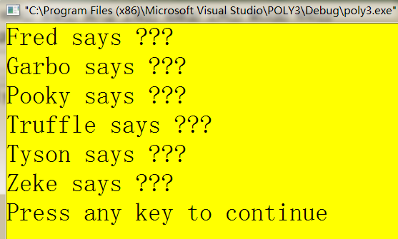
apcAnimals[i]->Speak() will call Animal::Speak()

Slide 38
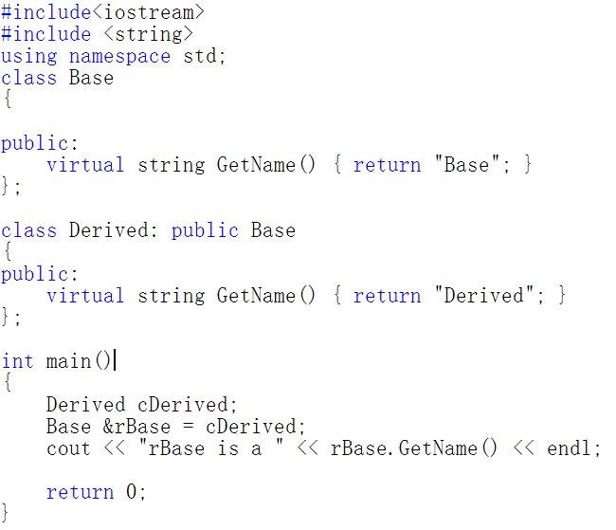
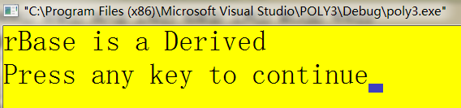
when rBase.GetName() is evaluated,
it would normally resolve to Base::GetName().
Base::GetName() is virtual, which tells the program to go look and see if there are any more-derived versions of the function available.
The program will check every inherited class between Base and Derived and use the most-derived version of the function that it finds.

Slide 39
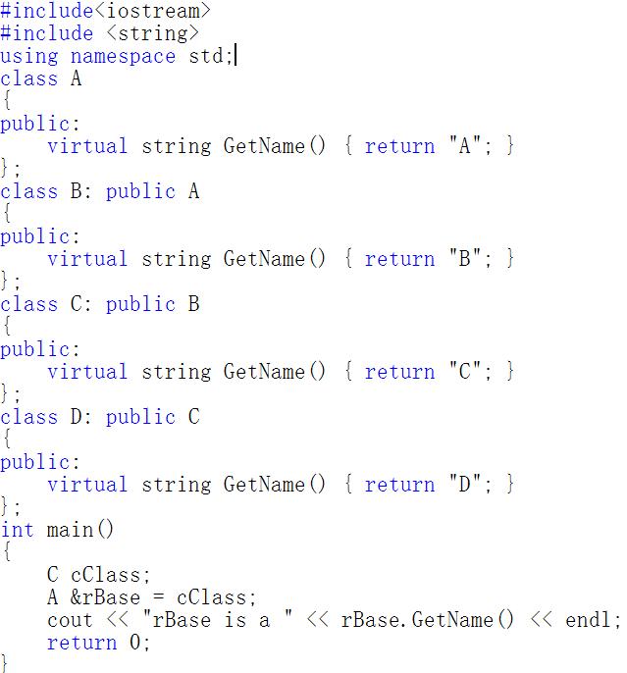
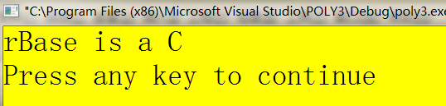

Slide 40
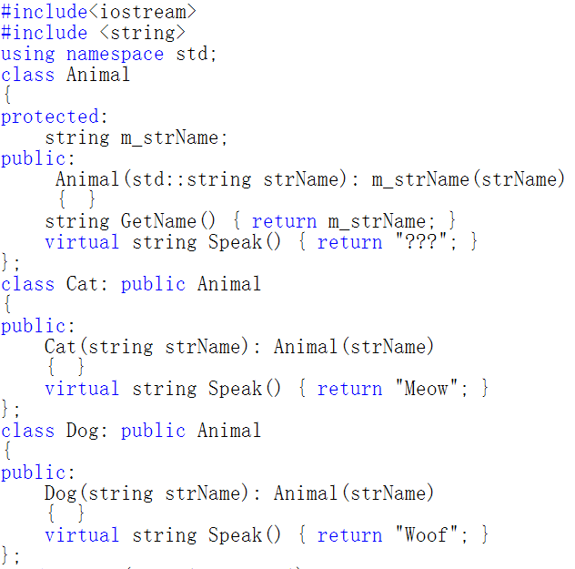

Slide 41
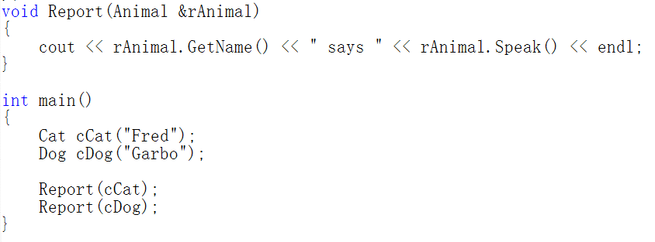
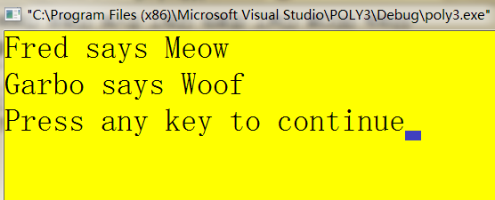

Slide 42
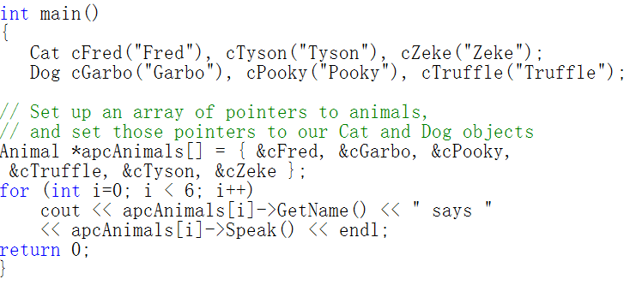
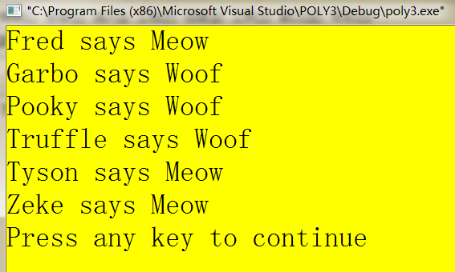

Slide 43
Destructor functions can be virtual?
YES
In large projects, the destructor of the derived class was not called at all.
This is where the virtual mechanism comes into our rescue. By making the Base class Destructor virtual, both the destructors will be called in order.
Such as, A* d = new B();

Slide 44
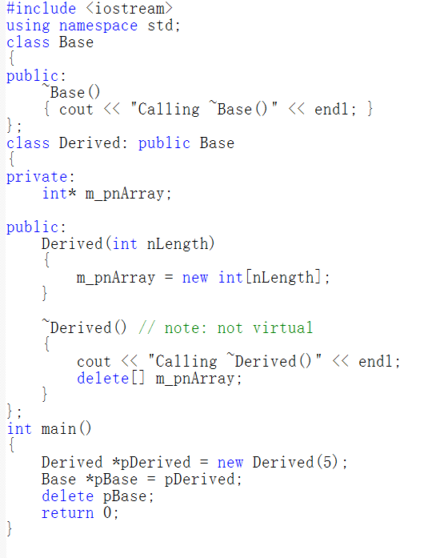

Slide 45
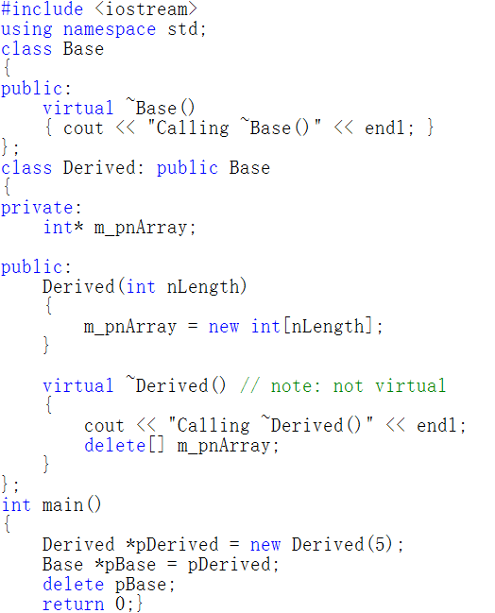

Slide 46
Inheritance?
  The same names of data members in base class and derived class?

Slide 47
Technicality: Overriding
To override a virtual function, you need
  A virtual function
  Exactly the same name
  Exactly the same type
  struct B {
  void f1(); // not virtual
  void f2(char);
  void f3(char) const;
  virtual void f4(int);
  };
  struct D : B {
  void f1(); // doesn’t override
  void f2(int); // doesn’t override
  void f3(char); // doesn’t override
  void f4(int); // overrides
  };
Notes:
多态是面向对象中的一个重要的概念，virtual是为多态而生的。

Slide 48
Inheritance: The Same Name
class Person{ // base class
protected:
char name[10]; // name
char sex; // gender
int id; // identity ID
};
class Student : public Person{ // derived class
private: int id; // student Id
char school[10]; // school
public: void test(){ //test number
id=123;
}
};
//Which one？

Slide 49
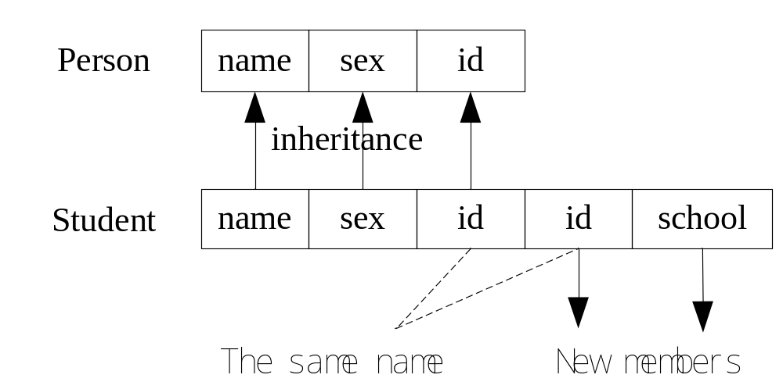
Inheritance: The Same Name

Slide 50
Inheritance: The Same Name
The way to solve this issue, using ”::”, such as
class: :member
class Student : public Person{ // derived class
private: int id; // student ID
……
public: void test(){
id=123; // call derived class member
Person::id =456; // call base class member
}
};

Slide 51
Language Mechanisms
Most popular definition of object-oriented programming:
  OOP == inheritance + polymorphism + encapsulation
Base and derived classes // inheritance
      struct Circle : Shape { … };
      Also called “inheritance”
Virtual functions // polymorphism
      virtual void draw_lines() const;
      Also called “run-time polymorphism” or “dynamic dispatch”
Private and protected // encapsulation
      protected: Shape();
      private: vector<Point> points;

